Slide 1
Noise in AM systems
Receiver Model
Carrier frequency is large compared to transmission bandwidth B_{T}, Filtered noise n(t) is treated as narrowband noise.
X(t) = s(t) + n(t)

Slide 2
Noise in AM systems
(SNR)i= ratio of average power of modulated signal s(t) to average power of filtered noise n(t).
(SNR)o: ratio of average power of demodulated signal to average power of noise, both measured at receiver output.
(SNR)c: ratio of average power of modulated signal to average power of channel noise in message bandwidth both measured at receiver input.

Slide 3
Noise Analysis in DSBSC
DSB-SC Receiver
Where
Average noise in message bandwidth W is WN₀

Slide 4
Noise Analysis in DSBSC
The total signal at coherent detector input is
The output at product modulator is
The output of low pass filter is

Slide 5
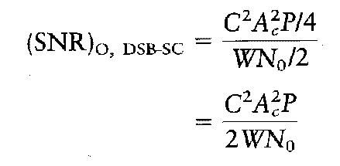
Noise Analysis in DSBSC
By definition
Substitute numerator and denominator values, we get
F=1

Slide 6
Noise in DSBFC
The AM signal s(t) is given by
The average power of carrier component is
The average power of information bearing component
Thus total power is

Slide 7
Noise in DSBFC
X(t) serves as input to envelope detector.
Thus, the output y(t)
The approximated output y(t) is

Slide 8
Noise in DSBFC
The DC term A_{C} can be ignored or can be blocked by using capacitor.
Thus,
F=

Slide 9
Threshold effect
When the carrier to noise ratio is less compared to unity then noise term dominates.
In such cases n(t) can be written as
The envelope output is
The detector output has no component proportional to message m(t). Thus m(t) is lost.

Slide 10
Noise in FM systems
The noise model of FM receiver is
Equivalently
Where

Slide 11
Noise in FM systems
FM signal s(t) is defined as
The noisy signal at band pass filter output

Slide 12
Noise in FM systems
The phasor diagram of x(t) is
For large carrier to noise ratio

Slide 13
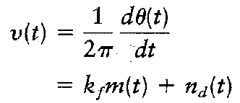
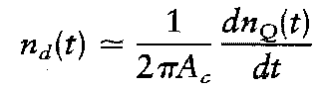
Noise in FM systems
The discriminator output is proportional to
Where n_{d} is

Slide 14
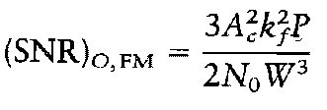
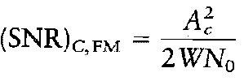
Noise in FM systems
To determine average output noise power, n_{d}(t) and n_{Q}(t) can be related as

